Slide 1
Improving Utility and Security of the Shuffler-based Differential Privacy
Tianhao Wang, Bolin Ding, Min Xu, Zhicong Huang, Jingren Zhou, Ninghui Li, Somesh Jha
Purdue University, Alibaba, University of Chicago, University of Wisconsin-Madison

Slide 2

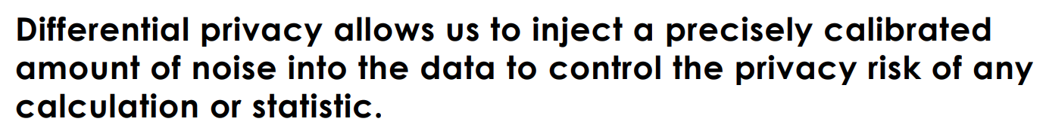

Differential Privacy in Census
Title 13: Private data is never published.
It is against the law to disclose or publish any private information that identifies an individual or business such, including names, addresses (including GPS coordinates), Social Security Numbers, and telephone numbers.

Slide 3
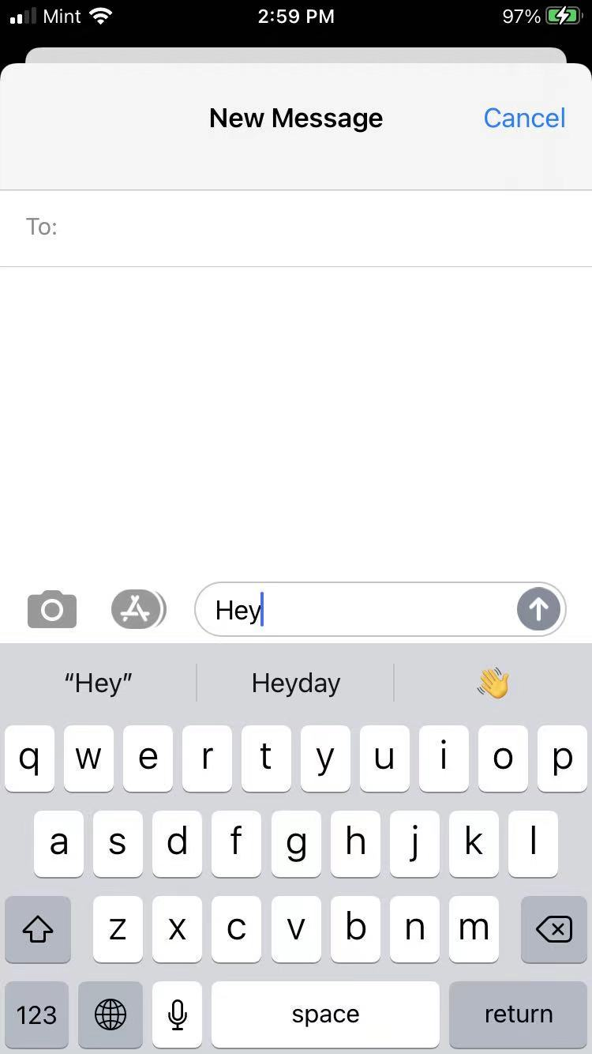
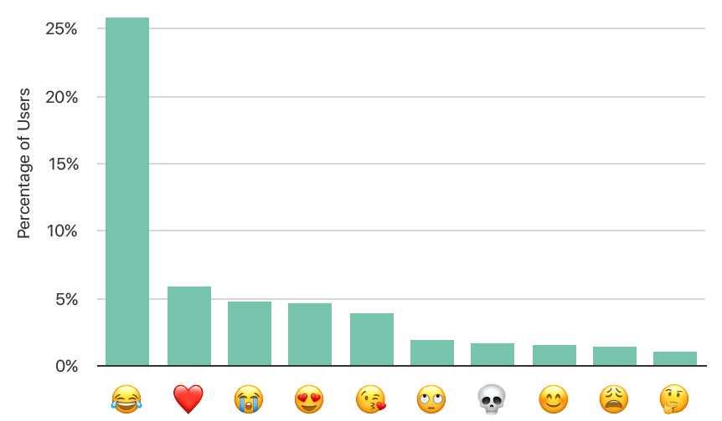


Industrial Setting: Local Differential Privacy
Local differential privacy has the advantage that the data is randomized before being sent from the device, so the server never sees or receives raw data.
However, local differential privacy is very limited in that it can only support simple tasks with large noise.
Privacy
Protection
…

Slide 4

Central
Differential Privacy
Shuffler-based Differential Privacy
Local
Differential Privacy
Trusted Non-collusion Servers
Single Trusted Server
No Need to Trust Server
Privacy
Protection
Privacy
Protection
…
…
…
Low Noise
Smaller Amount of Noise
High Noise

Slide 5

Layered Encryption
Prevent Server from Reading the Data
LDP Perturbation
Shuffle
LDP Estimation
Security aspect is not carefully investigated.
Erlingsson et al. “Amplification by shuffling: From local to central differential privacy via anonymity”, SODA, 2019
Bittau et al. “Prochlo: Strong privacy for analytics in the crowd”, SOSP, 2017.
Cheu et al. “Distributed differential privacy via shuffling”, EUROCRYPT, 2019.
Feldman et al. “Hiding Among the Clones: A Simple and Nearly Optimal Analysis of Privacy Amplification by Shuffling”, Preprint, 2021.
Balle et al. “The privacy blanket of the shuffle model”, CRYPTO, 2019.
Girgis et al. “On the Renyi Differential Privacy of the Shuffle Model”, CCS, 2021.

Slide 6

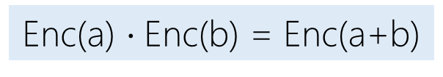
Collusion
Manipulation
Introduce multiple shufflers
Ask shufflers to add dummy reports
Oblivious shuffle + additive secret-sharing
Each round, half shufflers know the order
secret = a+b mod N
Homomorphic encryption
Enc(a) $\text{⋅}$Enc(b) = Enc(a+b)

Slide 7
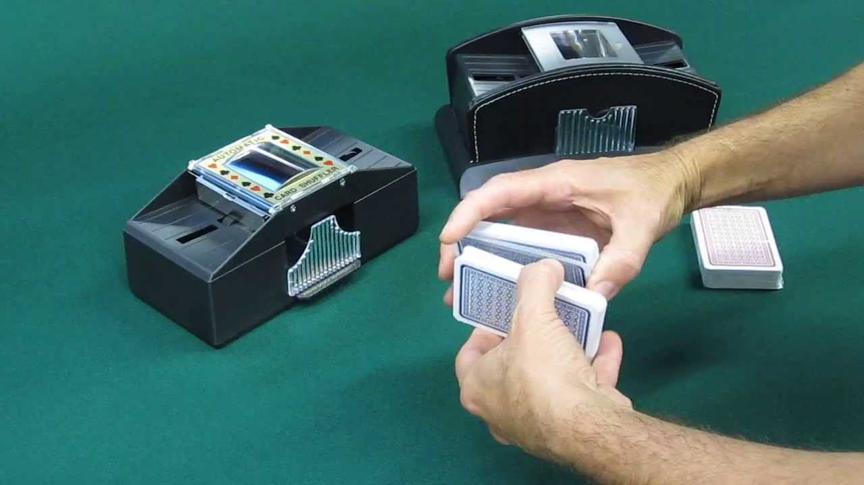
Enhancing Security
Privacy
Protection
…
A = a₁ + a₂ + a₃ mod N
b’₁ + b’₂ + b’₃ mod N = B
a₁
b₁
c₁
d₁
a₁ + a_{r}
b₁+ b_{r}
c₁+ c_{r}
d₁+ d_{r}
b₁'
d₁'
a₁'
c₁'
b₁+ b_{r}
d₁+ d_{r}
a₁+ a_{r}
c₁+ c_{r}
B = b₁ + b₂ + b₃ mod N
d’₁ + d’₂ + d’₃ mod N = D
a₂
b₂
c₂
d₂
b₃'
d₃'
a₃'
c₃'
Enc(a₃)
Enc(b₃)
Enc(c₃)
Enc(d₃)
Enc(a₂+a₃ - a_{r})
Enc(b₂+b₃ - b_{r})
Enc(c₂+c₃ - c_{r})
Enc(d₂+d₃ - d_{r})
Enc(a₃- a_{r})+a_{r}
Enc(b₃- b_{r})+b_{r}
Enc(c₃- c_{r})+c_{r}
Enc(d₃- d_{r})+d_{r}
Enc(b₂+b₃ - b_{r})
Enc(d₂+d₃ - d_{r})
Enc(a₂+ a₃ – a_{r})
Enc(c₂+ c₃ – c_{r})
C = c₁ + c₂ + c₃ mod N
Enc(b₂')
Enc(d₂')
Enc(a₂')
Enc(c₂')
a’₁ + a’₂ + a’₃ mod N = A
D = d₁ + d₂ + d₃ mod N
c’₁ + c’₂ + c’₃ mod N = C

Slide 8

Improving Accuracy
Existing results work for Randomized Response
Optimized Unary Encoding improves accuracy, at a high bandwidth
It is desired to use Optimized Local Hashing
Theorem: If each user executes OLH with $\text{ε}\text{−}\text{LDP}$, the overall process satisfies$\text{(}\text{ε}\text{′,}\text{δ}\text{)}\text{−}\text{DP}\text{,}$ where $\text{ε}\text{′=}\sqrt{\frac{\text{14}\text{ln}\text{(2/}\text{δ}\text{)(}{\text{e}}^{\text{ε}}\text{+}{\text{d}}^{\text{′}}\text{−1)}}{\text{n}\text{−1}}}$, and the overall accuracy is optimized when ${\text{d}}^{\text{′}}=\frac{{\text{ε}\text{′}}^{\text{2}}\text{(}\text{n}\text{−1)}}{\text{42}\text{ln}\text{(2/}\text{δ}\text{)}}\text{+}\frac{\text{2}}{\text{3}}$.
Notes:
By a simple argument, we show we can use OUE, which was proposed in the usenix security 17 paper I presented earlier. The idea is similar to

Slide 9

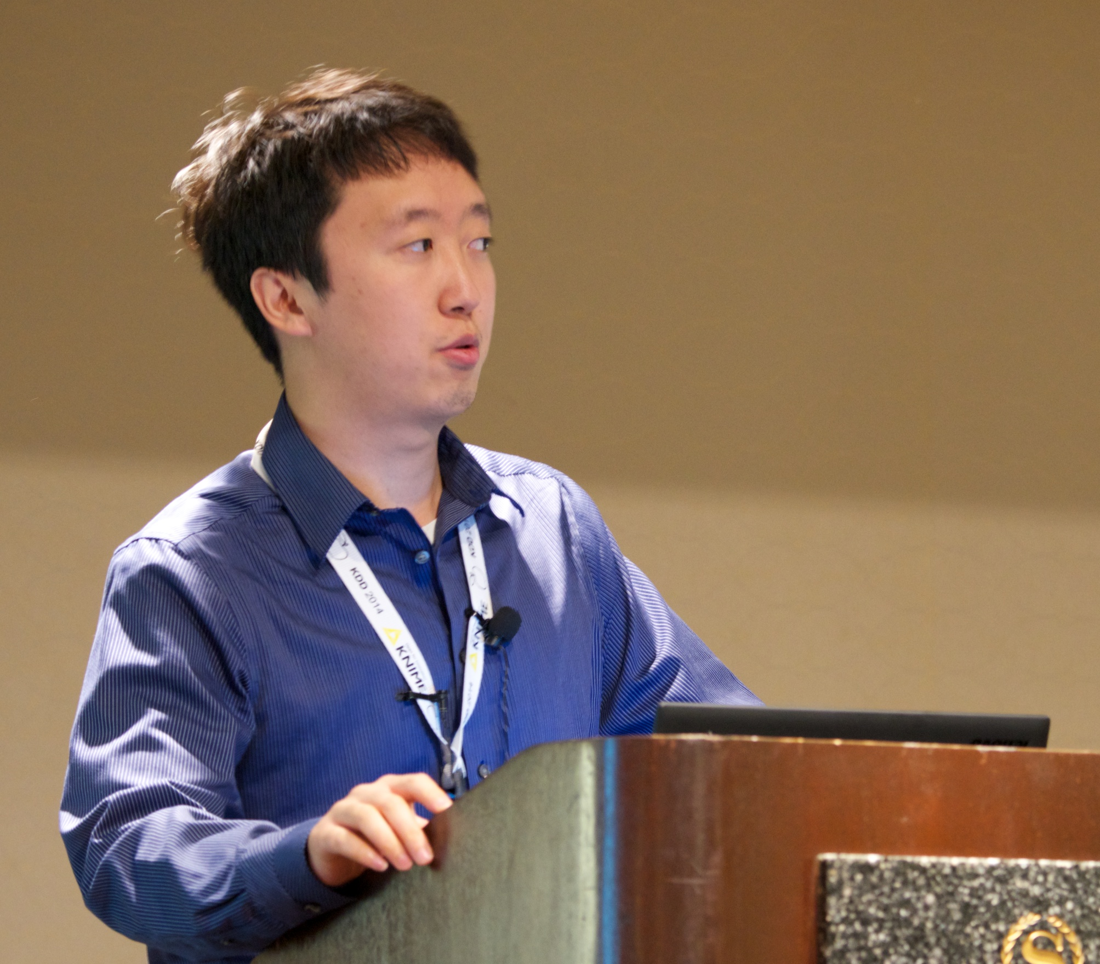






Improving Utility and Security of the Shuffler-based Differential Privacy
Tianhao Wang
Purdue
→CMU PostDoc
→UVa
Bolin Ding
Alibaba
Min Xu
Uchicago
→Facebook
Bolin Ding
Alibaba
Cheng Hong
Alibaba
Jingren Zhou
Alibaba
Ninghui Li
Purdue
Somesh Jha
UWisconsin

Slide 10
Analyzing Security
All parties could misbehave
They can even collaborate to misbehave
Incentives/goals: infer sensitive information, disrupt the result
Threats:
Collusions: multiple shufflers and add noise (dummy LDP reports)
Shufflers changes the result: additive secret-sharing (sec = a+b mod N)
Shufflers recovers the result: oblivious shuffle + homomorphic encryption
Notes:
We are probably the first to investigate the security aspects of these models

Slide 11

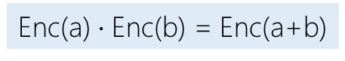
Layered Encryption
Prevent Server from Reading the Data
Bittau et al. “Prochlo: Strong privacy for analytics in the crowd,” SOSP, 2017.
Erlingsson et al. “Amplification by shuffling: From local to central differential privacy via anonymity,” SODA, 2019
LDP Perturbation
Shuffle
LDP Estimation
Cheu et al. “Distributed differential privacy via shuffling,” EUROCRYPT, 2019.
Balle et al. “The privacy blanket of the shuffle model,” CRYPTO, 2019.
Chowdhury et al. “Crypt$\text{ε}$: Crypto-assisted differential privacy on untrusted servers,” SIGMOD, 2020
One-hot Encode
+
Homomorphically Encrypt Each Bit
Aggregation
+
Add Noise
Decryption
Because of the communication cost, we choose to study the shuffler model
Enc(a) $\text{⋅}$Enc(b) = Enc(a+b)
Notes:
We leave it as a future work

Slide 12
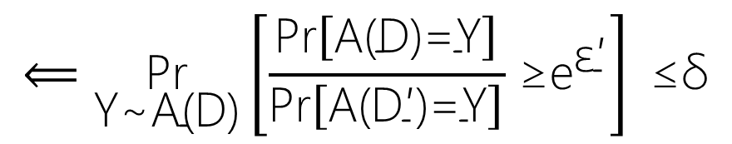
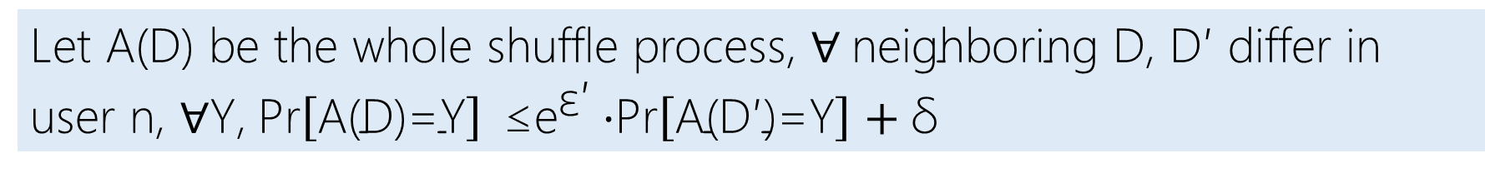
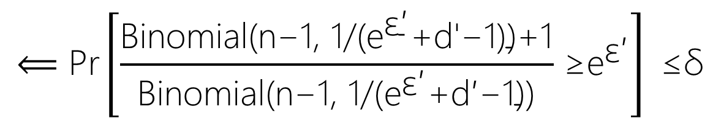
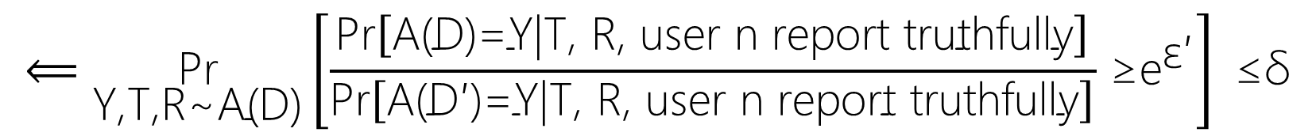
Let A(D) be the whole shuffle process, $\text{∀} \text{neighboring} \text{D}\text{, }\text{D}\text{′ }\text{differ} \text{in} \text{user} \text{n}\text{, ∀}\text{Y}$,$\text{Pr}\left[\text{A}\text{(}\text{D}\text{)=}\text{Y}\right] \text{≤}{\text{e}}^{\text{ε}\text{′}}\text{⋅}\text{Pr}\left[\text{A}\text{(}\text{D}\text{′)=}\text{Y}\right]+\text{δ}$
$$⟸\underset{\text{Y}\text{\sim }\text{A}\text{(}\text{D}\text{)}}{\text{Pr}}\left[\frac{\text{Pr}\left[\text{A}\text{(}\text{D}\text{)=}\text{Y}\right]}{\text{Pr}\left[\text{A}\text{(}\text{D}\text{′)=}\text{Y}\right]}{\text{≥}\text{e}}^{\text{ε}\text{′}}\right]\text{ ≤}\text{δ}$$
Set of other users who report truthfully
Their reports
$$⟸\underset{\text{Y}\text{,}\text{T}\text{,}\text{R}\text{\sim }\text{A}\text{(}\text{D}\text{)}}{\text{Pr}}\left[\frac{\text{Pr}\left[\text{A}\text{(}\text{D}\text{)=}\text{Y}\text{|}\text{T}\text{, }\text{R}\text{,} \text{user} \text{n} \text{report} \text{truthfully}\right]}{\text{Pr}\left[\text{A}\text{(}\text{D}\text{′)=}\text{Y}\text{|}\text{T}\text{, }\text{R}\text{, }\text{user} \text{n} \text{report} \text{truthfully}\right]}{\text{≥}\text{e}}^{\text{ε}\text{′}}\right]\text{ ≤}\text{δ}$$
Expanding the probabilities, converting it to counting problem, etc.
$$⟸\text{P}\text{r}\left[\frac{\text{B}\text{inomial}\text{(}\text{n}\text{−1, 1/(}{\text{e}}^{\text{ε}\text{′}}\text{+}\text{d}\text{′}\text{−1)}\text{)}\text{+}\text{1}}{\text{Binomial}\text{(}\text{n}\text{−1, 1/(}{\text{e}}^{\text{ε}\text{′}}\text{+}\text{d}\text{′−1))}}{\text{≥}\text{e}}^{\text{ε}\text{′}}\right]\text{ ≤}\text{δ}$$

